Slide 1
FINARYA
List My Assigned Entities
Screen mock-up set — Audit landing page, ticket-based branch list, in Populated, Search and Empty states
Open interactive HTML prototype ↗
Keep this PPTX and Finarya_ListMyAssignedEntities_Prototype.html in the same folder for the link above to open correctly.
Brand colours used: #016EBA · #1375BE · #FEC400

Slide 2
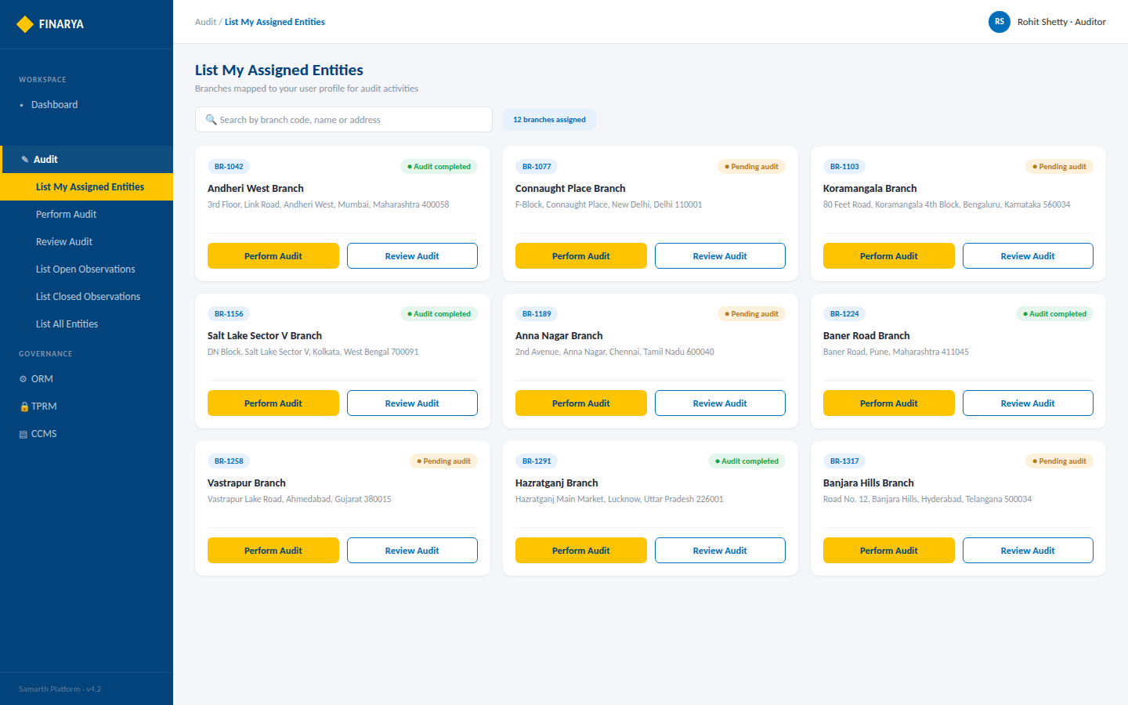
FINARYA
List My Assigned Entities — Populated (Auditor)
Ticket-based branch grid · search bar · Perform Audit + Review Audit actions
Finarya — Reimagine Governance
Open interactive protoxtype ↗
3

Slide 3
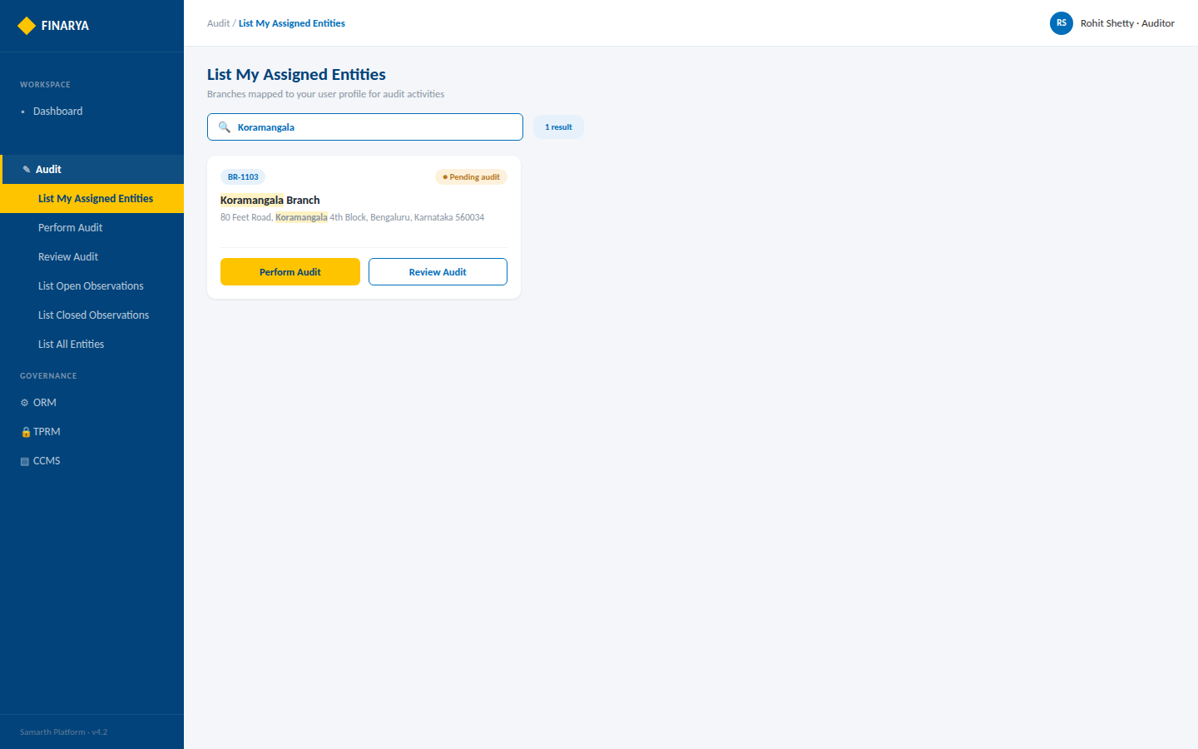
FINARYA
List My Assigned Entities — Search Active
Live filter across Branch Code, Branch Name and Branch Address
Finarya — Reimagine Governance
Open interactive prototype ↗
4

Slide 4
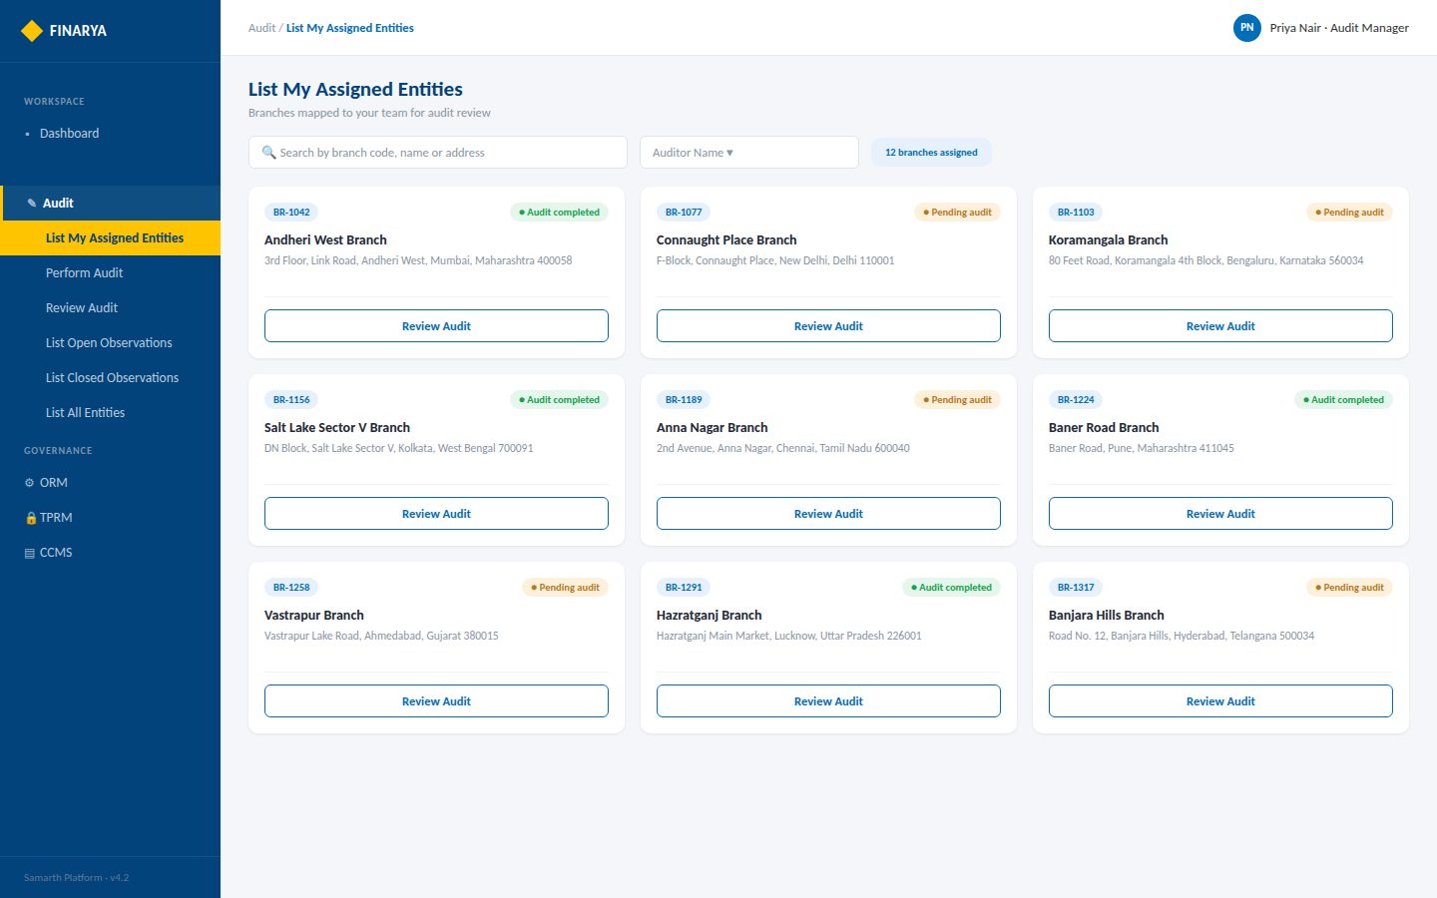
FINARYA
List My Assigned Entities — Populated (Audit Manager)
Review Audit only — Perform Audit hidden for the Audit Manager role
Finarya — Reimagine Governance
Open interactive prototype ↗
5

Slide 5
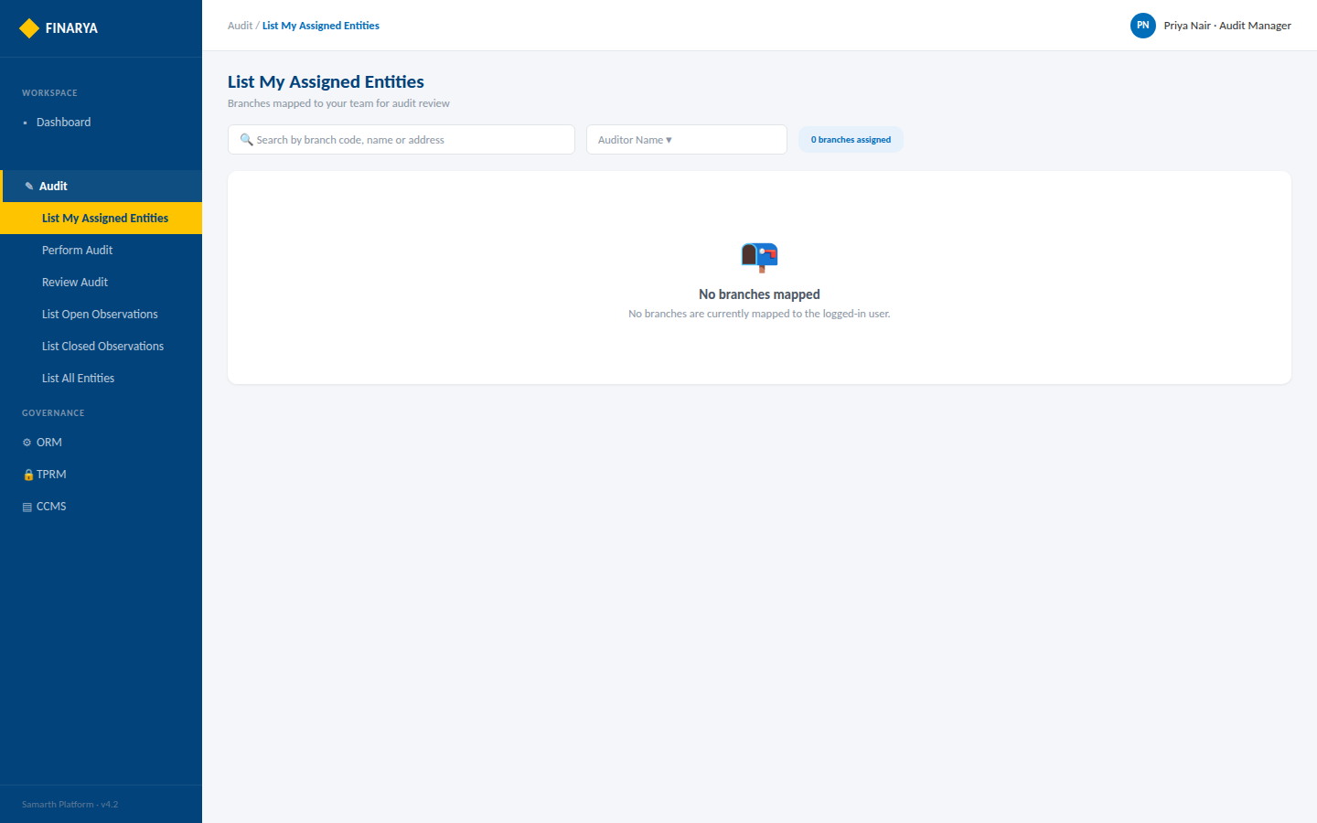
FINARYA
List My Assigned Entities — Empty State
No branches mapped to the logged-in user
Finarya — Reimagine Governance
Open interactive prototype ↗
6

Slide 6
FINARYA
Perform Audit
Screen mock-up set — tab-based audit workflow: Geo Tag, Branch Details, Open / Closed Observations, Detailed Observations, Summary, and key action dialogs
Open interactive HTML prototype ↗
Keep this PPTX and Finarya_PerformAudit_Prototype.html in the same folder for the link above to open correctly.
Brand colours used: #016EBA · #1375BE · #FEC400

Slide 7
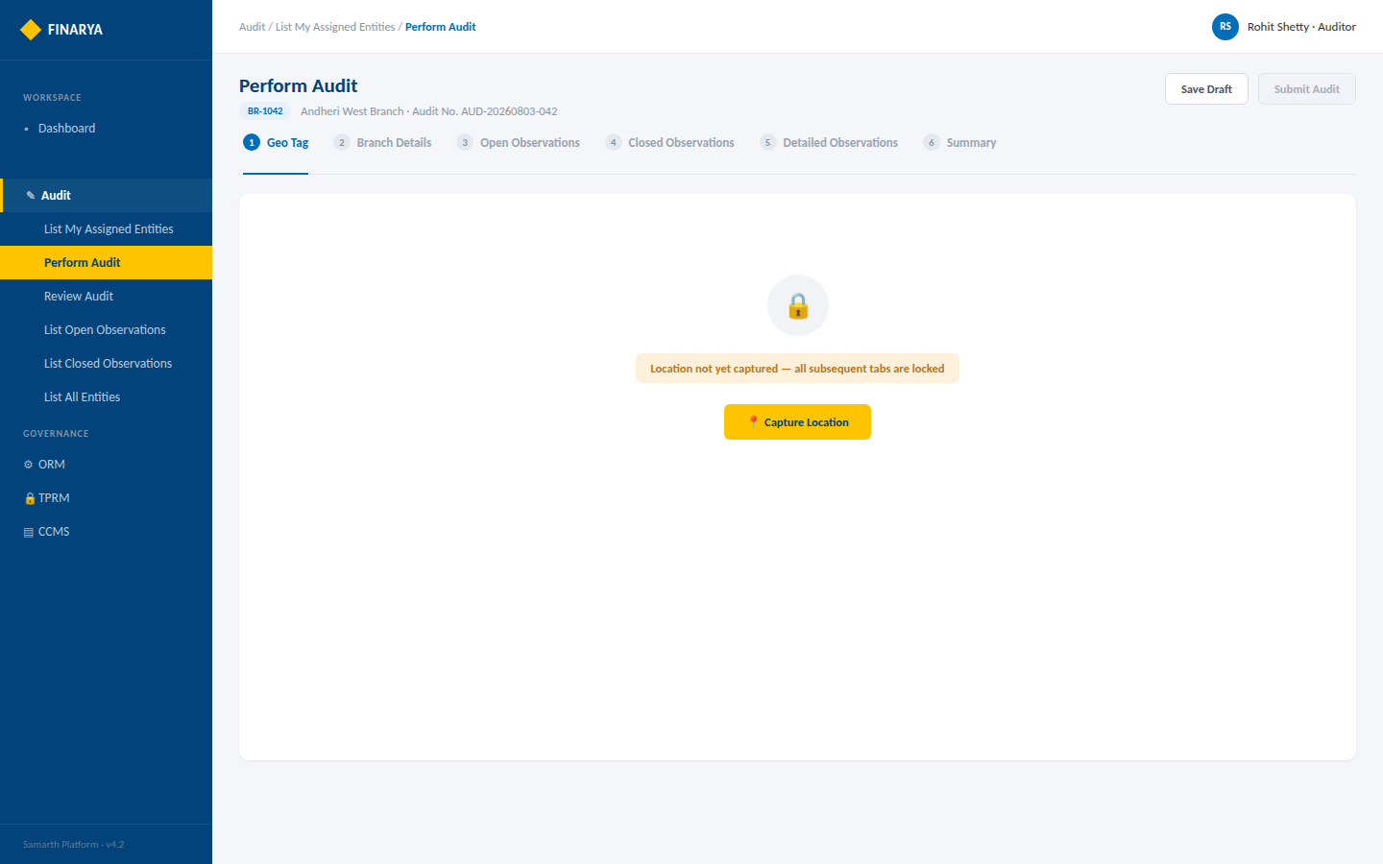
FINARYA
1. Geo Tag — Locked State
All subsequent tabs disabled until location is captured
Finarya — Reimagine Governance
Open interactive prototype ↗
3

Slide 8
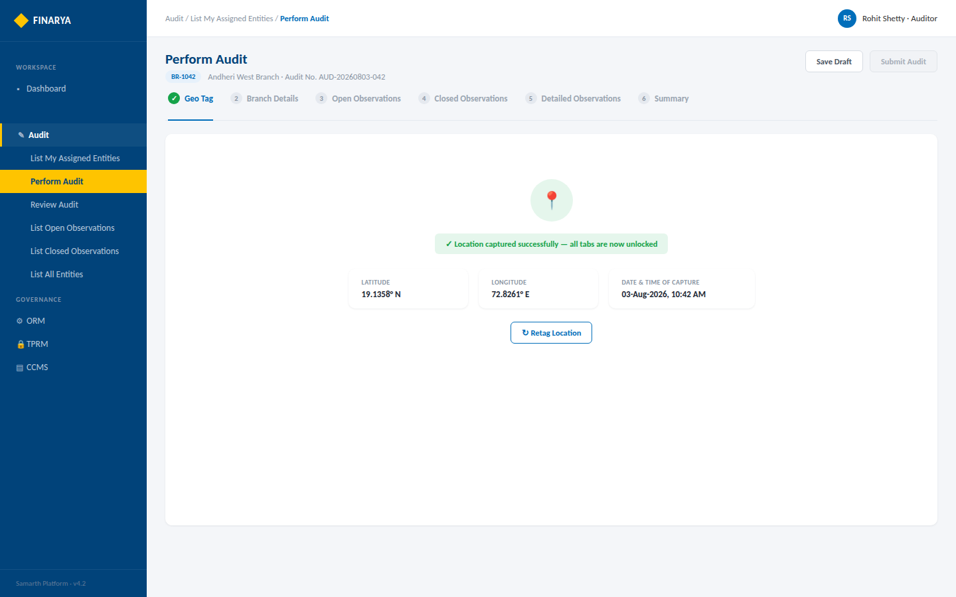
FINARYA
1. Geo Tag — Captured
Latitude, longitude and timestamp captured read-only · Retag available
Finarya — Reimagine Governance
Open interactive prototype ↗
4

Slide 9
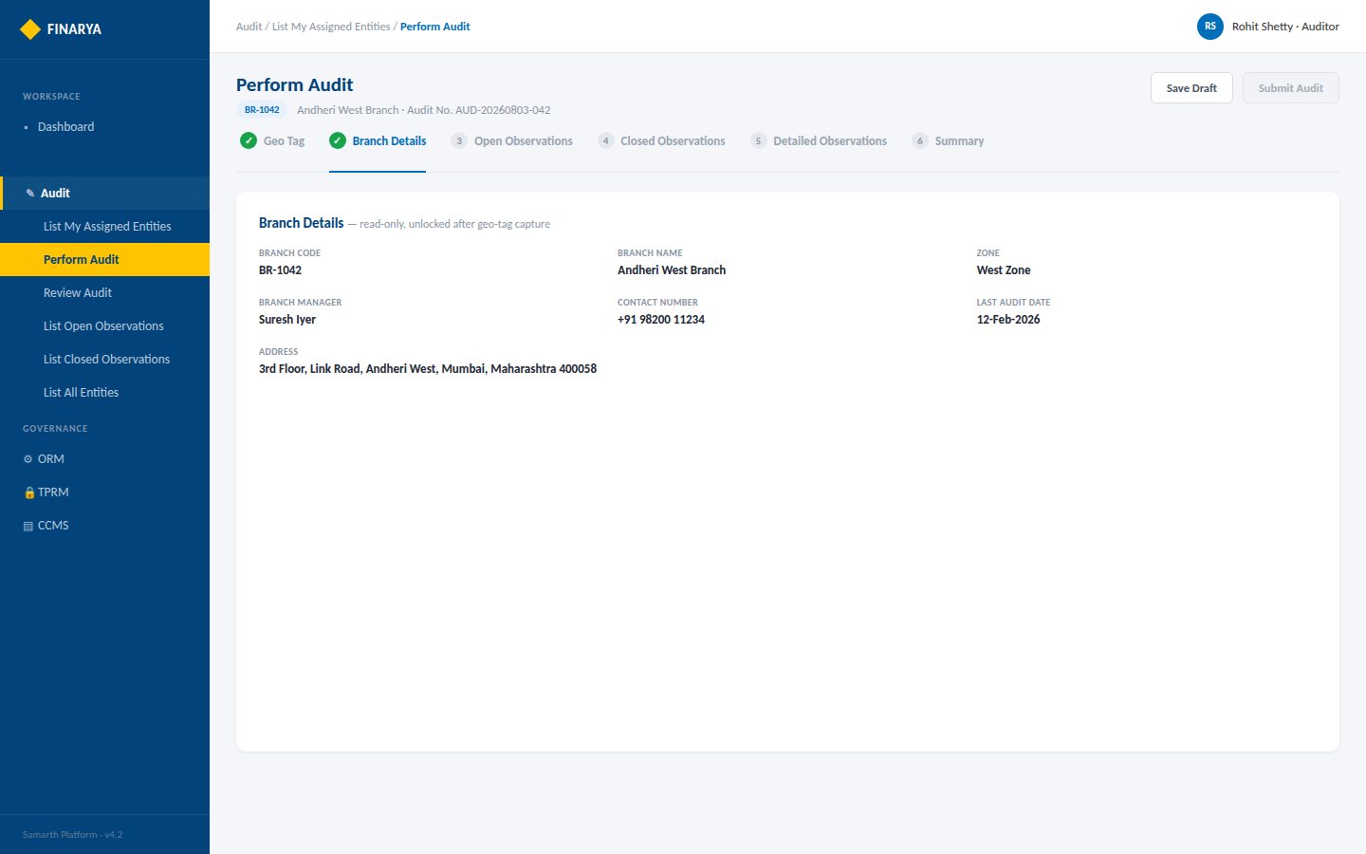
FINARYA
2. Branch Details
Read-only branch information, unlocked after geo-tag capture
Finarya — Reimagine Governance
Open interactive prototype ↗
5

Slide 10
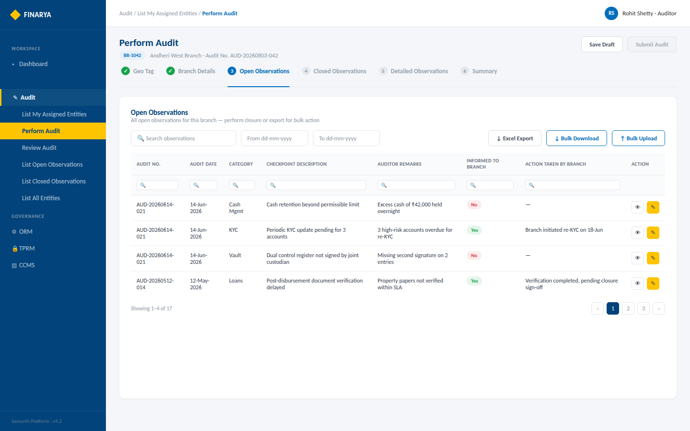
FINARYA
3. Open Observations
Paginated table · column search · date range · Excel export · bulk download/upload
Finarya — Reimagine Governance
Open interactive prototype ↗
6

Slide 11
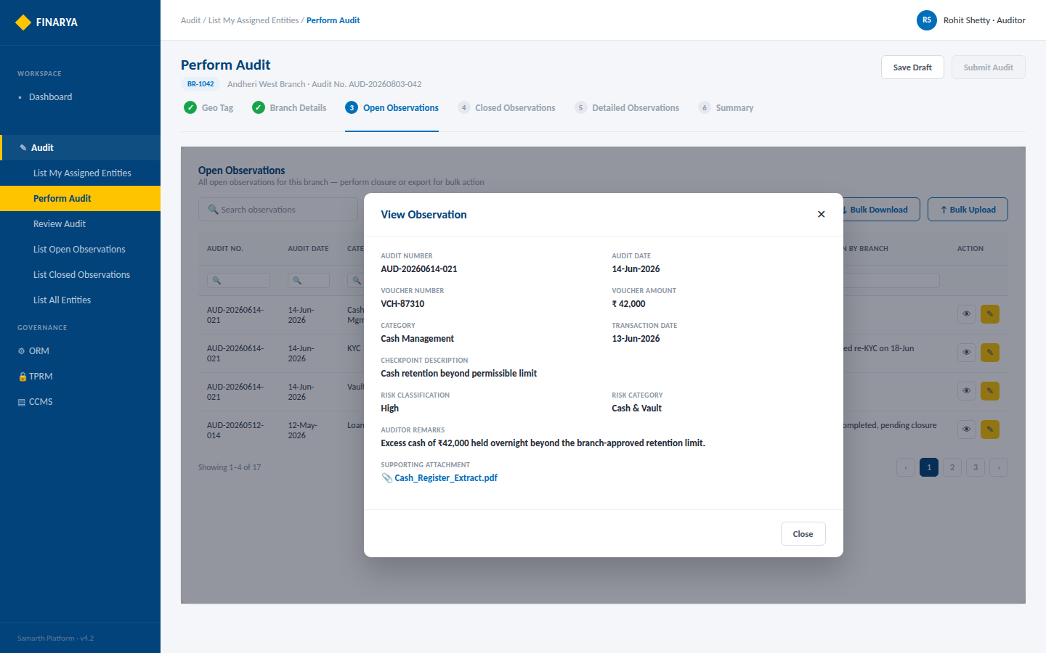
FINARYA
3a. View Observation — Dialog
Read-only popup with full observation and attachment details
Finarya — Reimagine Governance
Open interactive prototype ↗
7

Slide 12
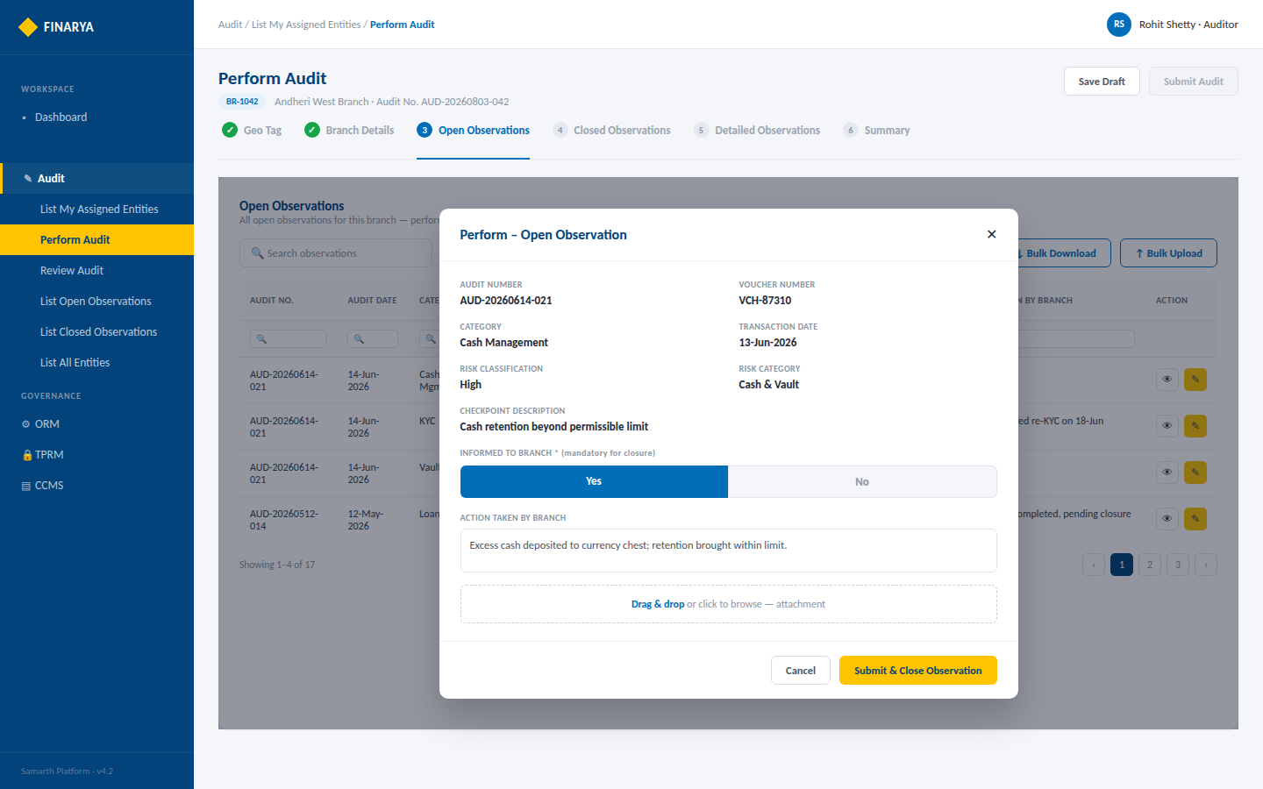
FINARYA
3b. Perform Observation — Dialog
Informed to Branch, Action Taken and attachment — submission closes the observation
Finarya — Reimagine Governance
Open interactive prototype ↗
8

Slide 13
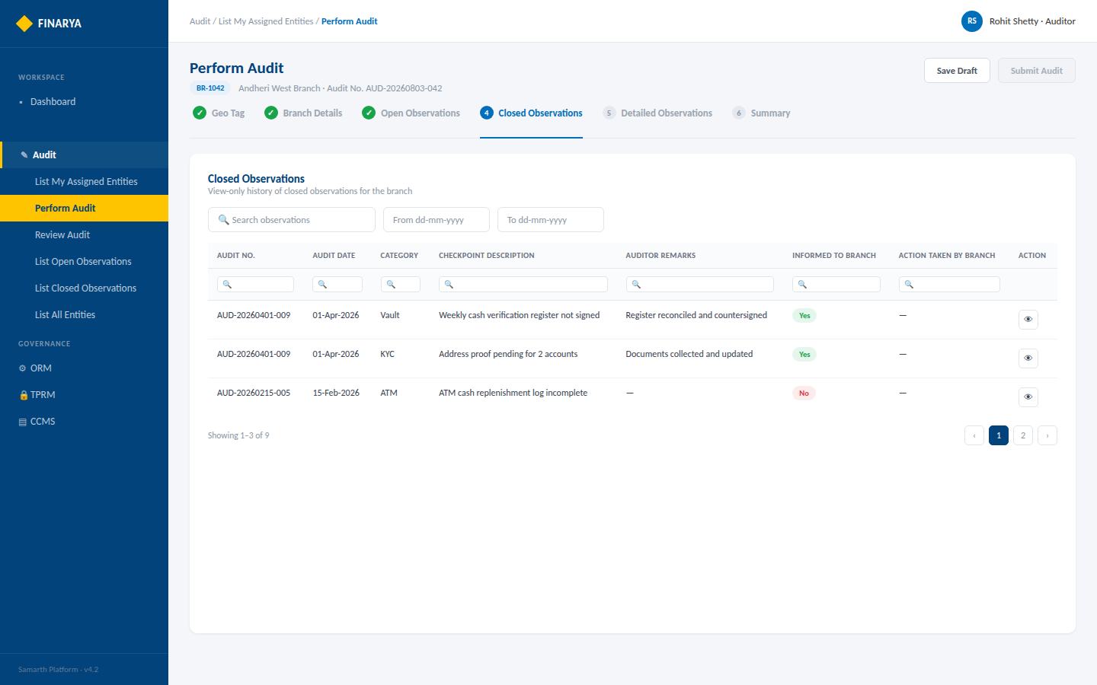
FINARYA
4. Closed Observations
View-only history of closed observations for the branch
Finarya — Reimagine Governance
Open interactive prototype ↗
9

Slide 14
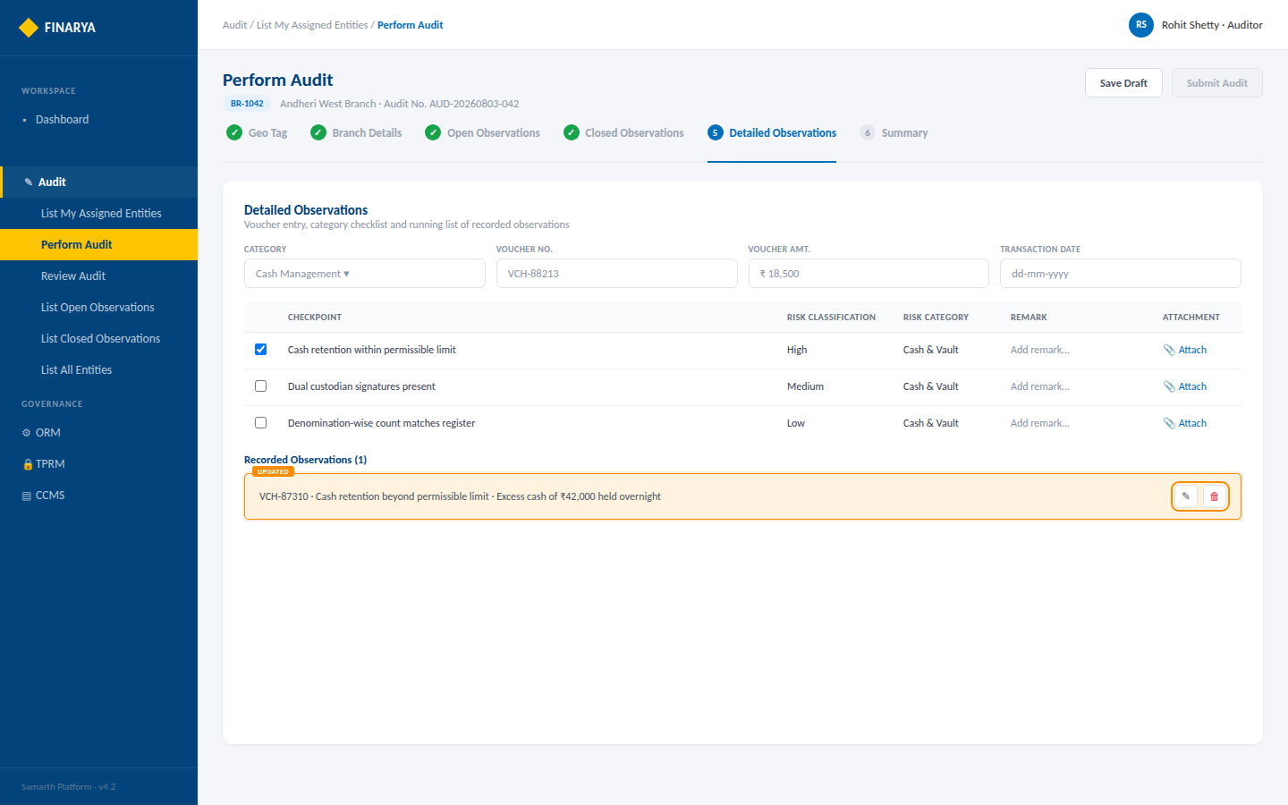
FINARYA
5. Detailed Observations
Voucher entry, category checklist and running list of recorded observations
Finarya — Reimagine Governance
Open interactive prototype ↗
10

Slide 15
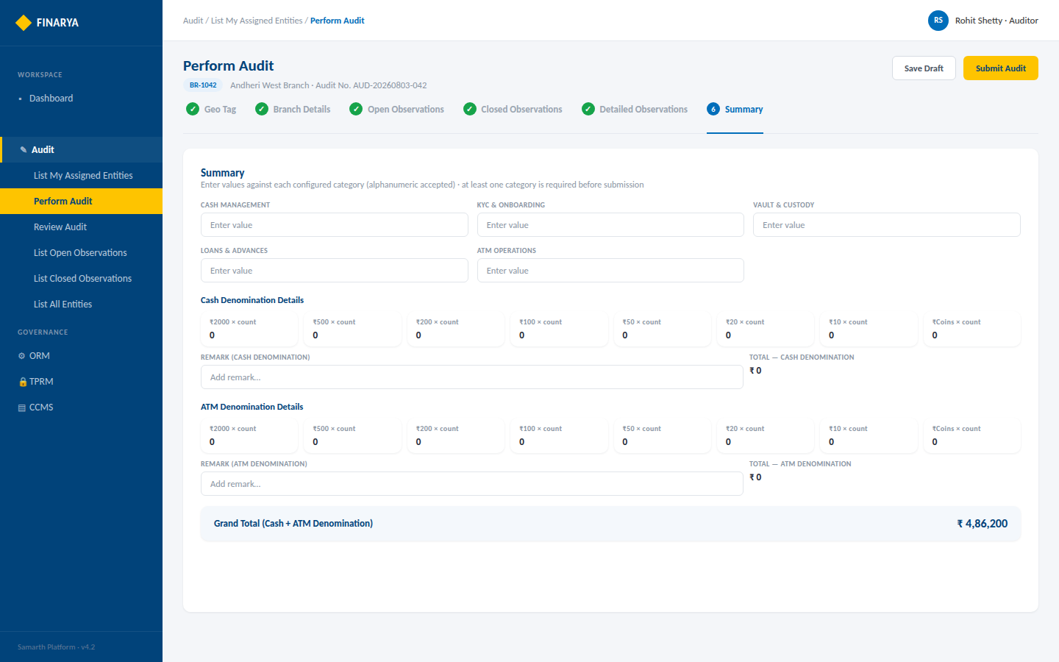
FINARYA
6. Summary
Category values plus Cash and ATM denomination with auto-calculated total
Finarya — Reimagine Governance
Open interactive prototype ↗
11

Slide 16
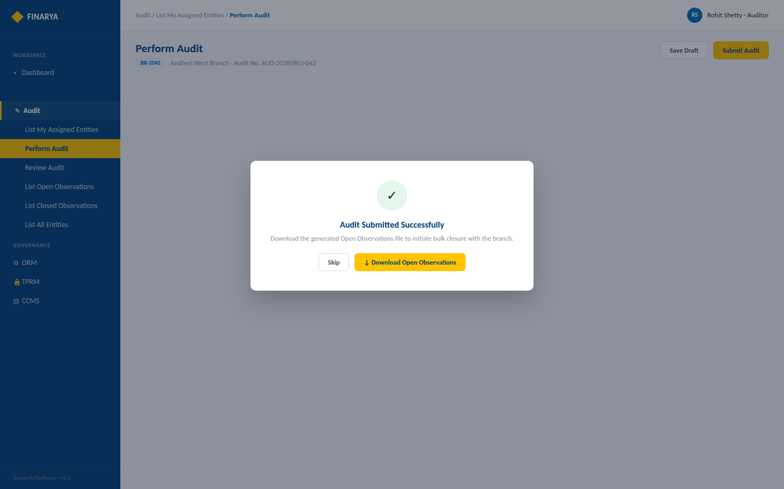
FINARYA
Final Submission — Download Prompt
Post-submission confirmation to download generated Open Observations for bulk closure
Finarya — Reimagine Governance
Open interactive prototype ↗
12

Slide 17
FINARYA
Review Audit
Screen mock-up set — role-based audit history listing, plus the read-only Audit View reusing the Perform Audit tab layout
Open interactive HTML prototype ↗
Keep this PPTX and Finarya_ReviewAudit_Prototype.html in the same folder for the link above to open correctly.
Brand colours used: #016EBA · #1375BE · #FEC400

Slide 18
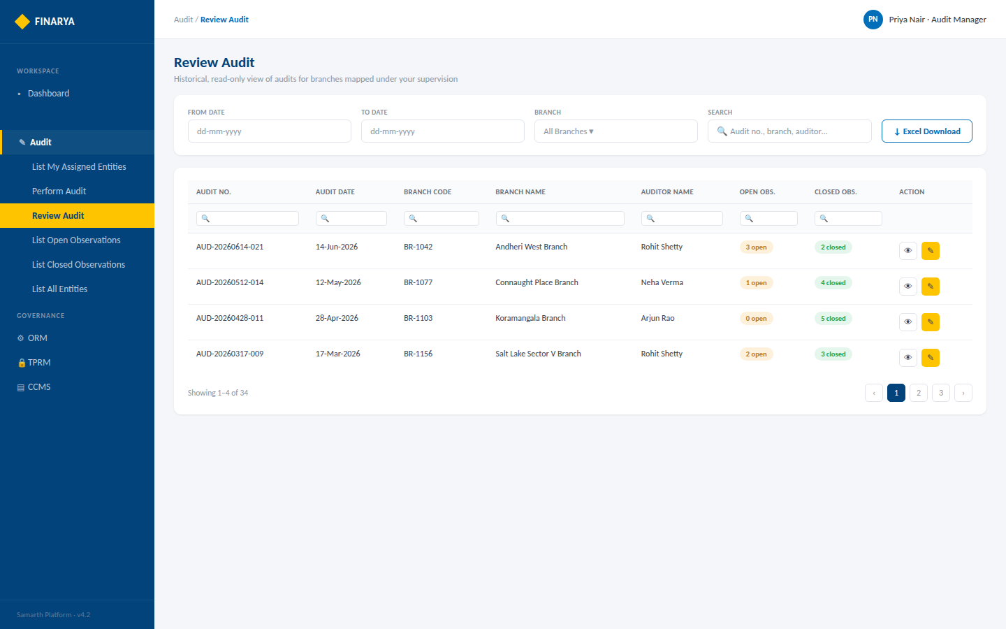
FINARYA
Review Audit — List (Administrator / Audit Manager)
Branch filter visible · From/To date, search and Excel download
Finarya — Reimagine Governance
Open interactive prototype ↗
3

Slide 19
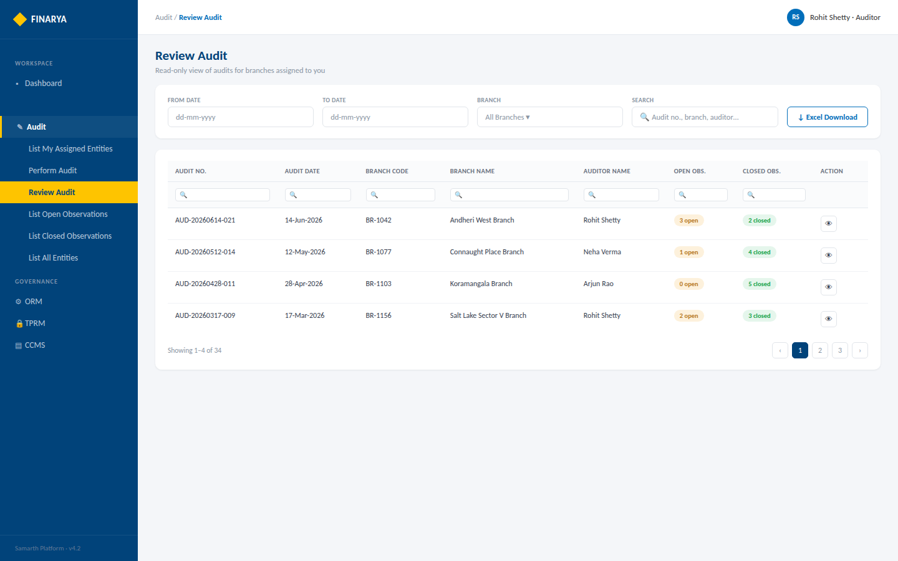
FINARYA
Review Audit — List (Auditor)
No Branch filter — scoped automatically to assigned branches
Finarya — Reimagine Governance
Open interactive prototype ↗
4

Slide 20
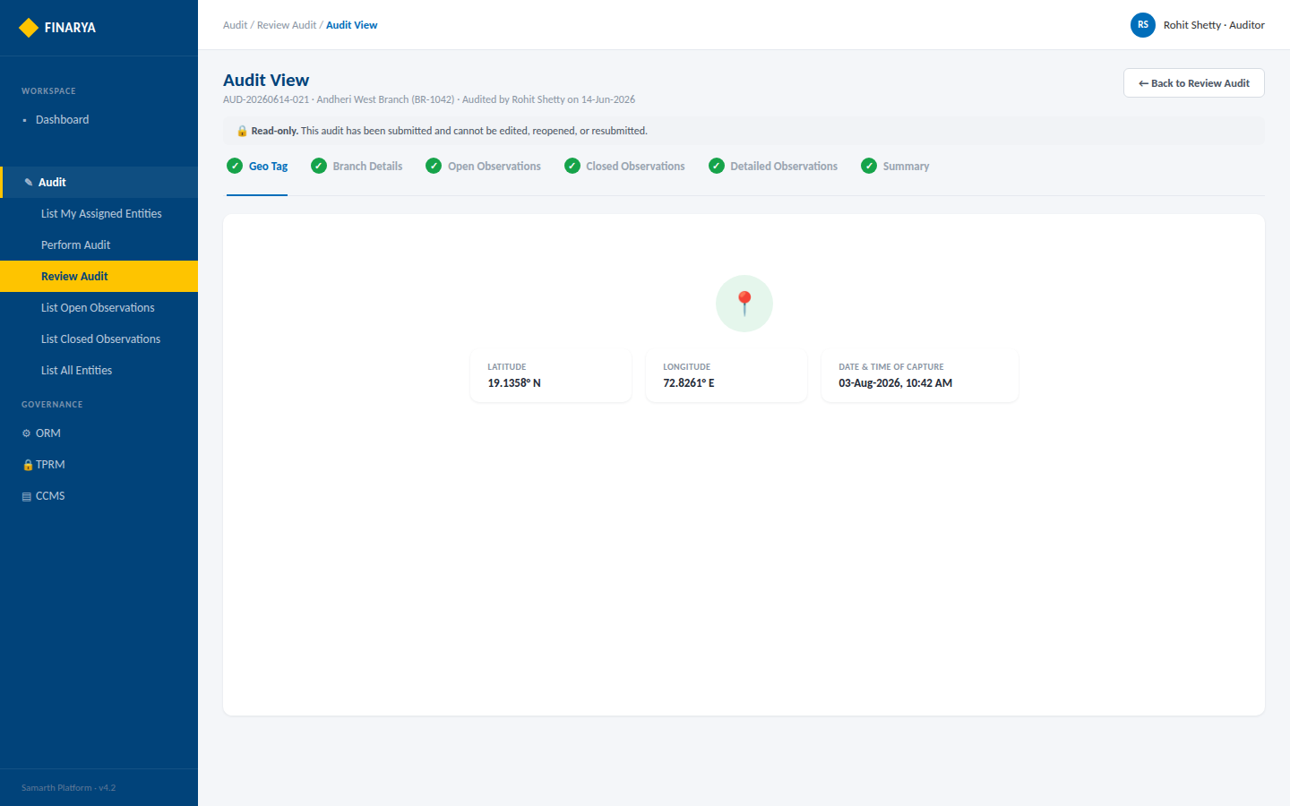
FINARYA
Audit View — Geo Tag
Read-only banner · latitude, longitude and capture timestamp as recorded
Finarya — Reimagine Governance
Open interactive prototype ↗
5

Slide 21
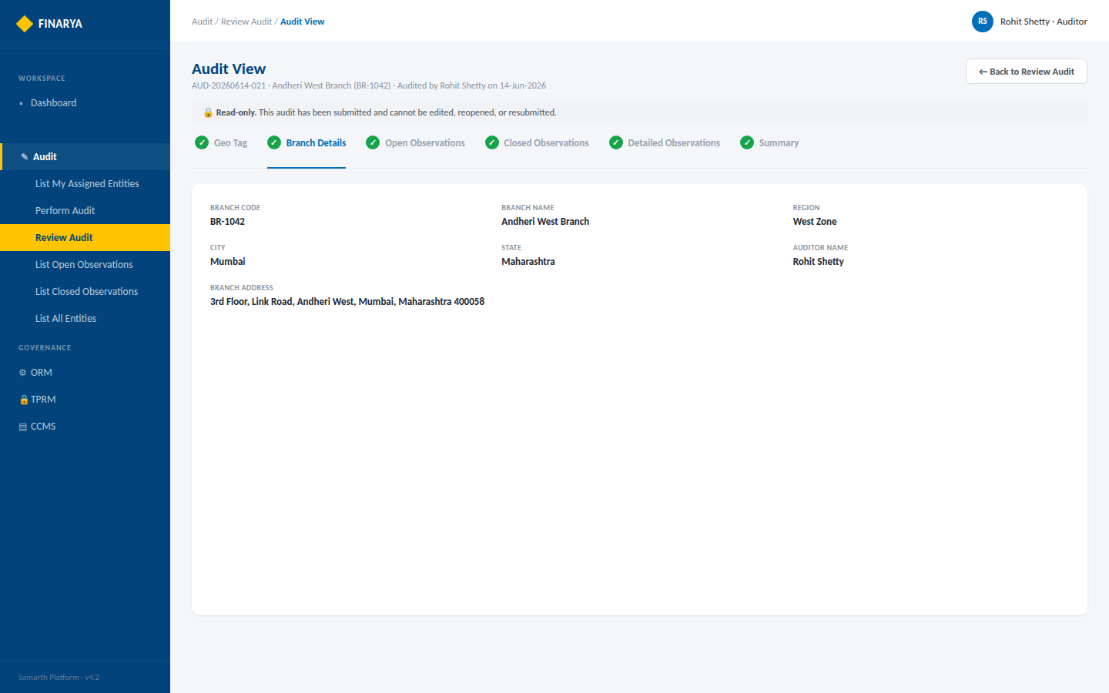
FINARYA
Audit View — Branch Details
Branch information exactly as captured at the time of audit
Finarya — Reimagine Governance
Open interactive prototype ↗
6

Slide 22
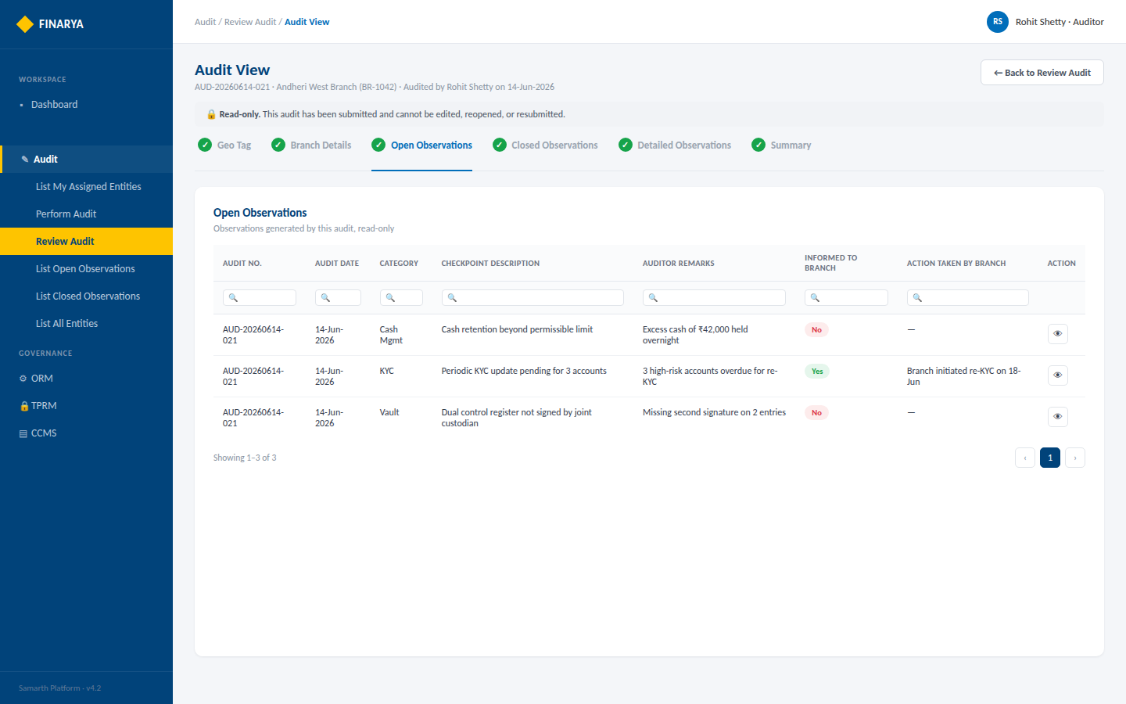
FINARYA
Audit View — Open Observations
Observations generated by this audit, read-only
Finarya — Reimagine Governance
Open interactive prototype ↗
7

Slide 23
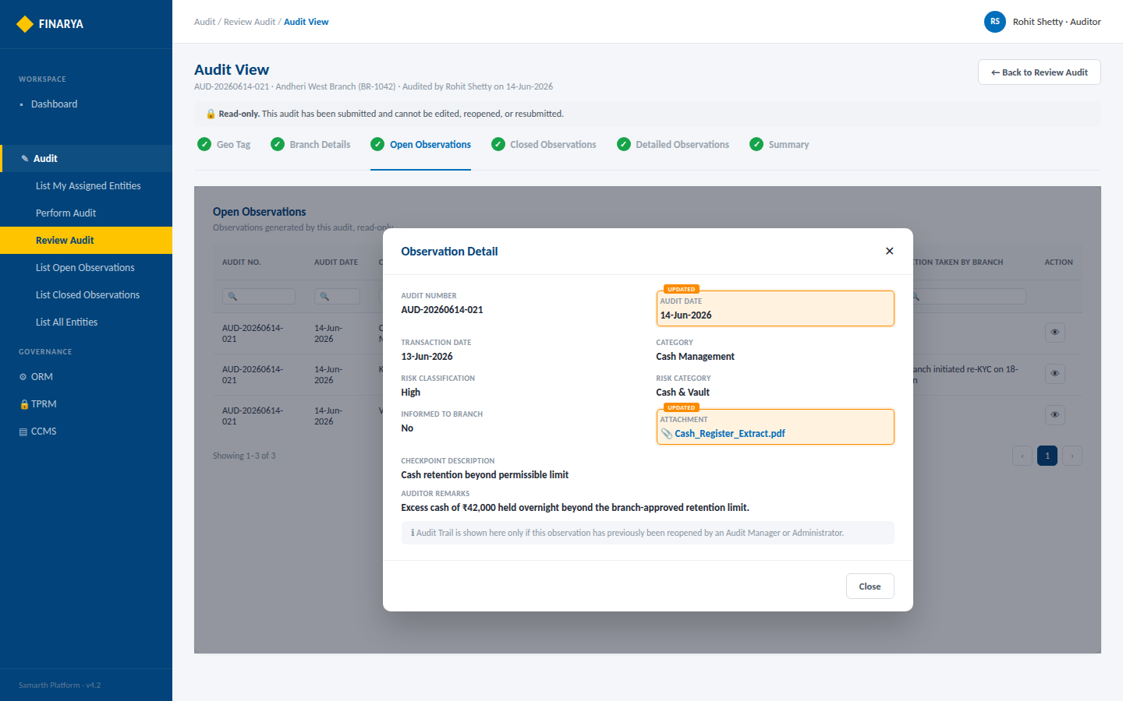
FINARYA
Audit View — Observation Detail with Audit Trail
Full observation detail plus a chronological audit trail
Finarya — Reimagine Governance
Open interactive prototype ↗
8

Slide 24
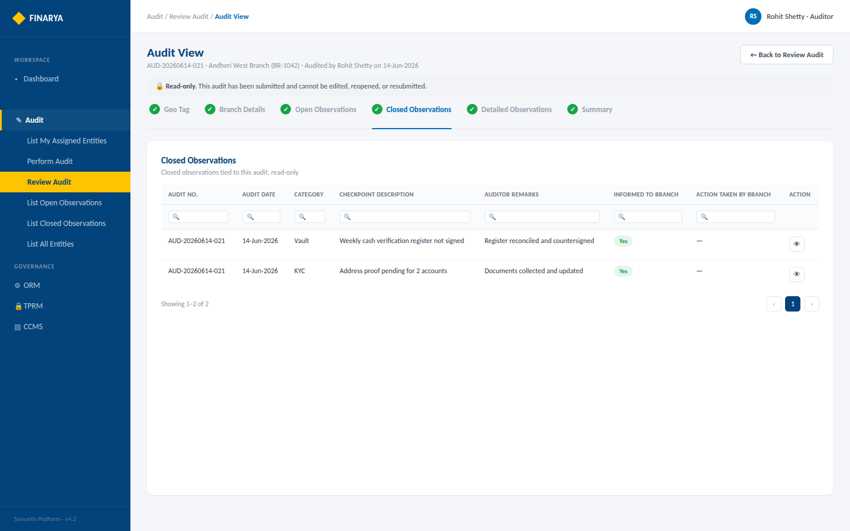
FINARYA
Audit View — Closed Observations
Closed observations tied to this audit, read-only
Finarya — Reimagine Governance
Open interactive prototype ↗
9

Slide 25
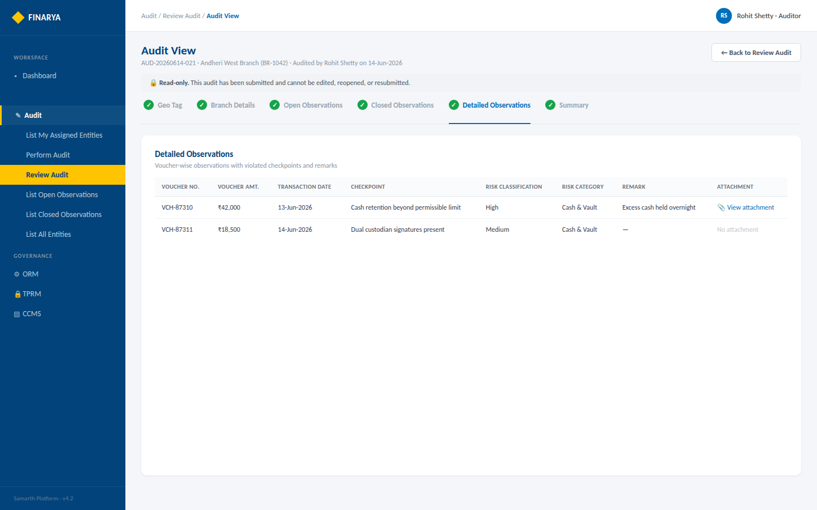
FINARYA
Audit View — Detailed Observations
Voucher-wise observations with violated checkpoints and remarks
Finarya — Reimagine Governance
Open interactive prototype ↗
10

Slide 26
FINARYA
List Open Observations
Screen mock-up set — role-based observation grid, individual View/Perform actions, and the Bulk Download / Bulk Upload closure workflow
Open interactive HTML prototype ↗
Keep this PPTX and Finarya_ListOpenObservations_Prototype.html in the same folder for the link above to open correctly.
Brand colours used: #016EBA · #1375BE · #FEC400

Slide 27
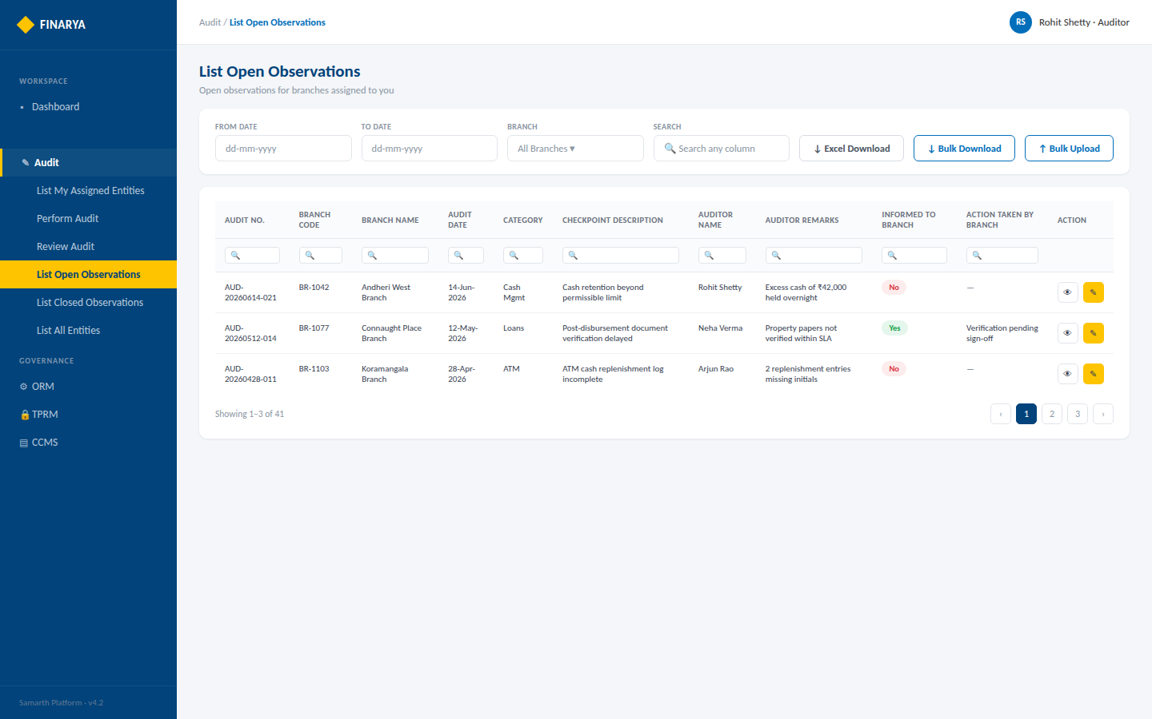
FINARYA
List Open Observations — Auditor
Full toolbar — Excel Download, Bulk Download, Bulk Upload, View + Perform actions
Finarya — Reimagine Governance
Open interactive prototype ↗
3

Slide 28
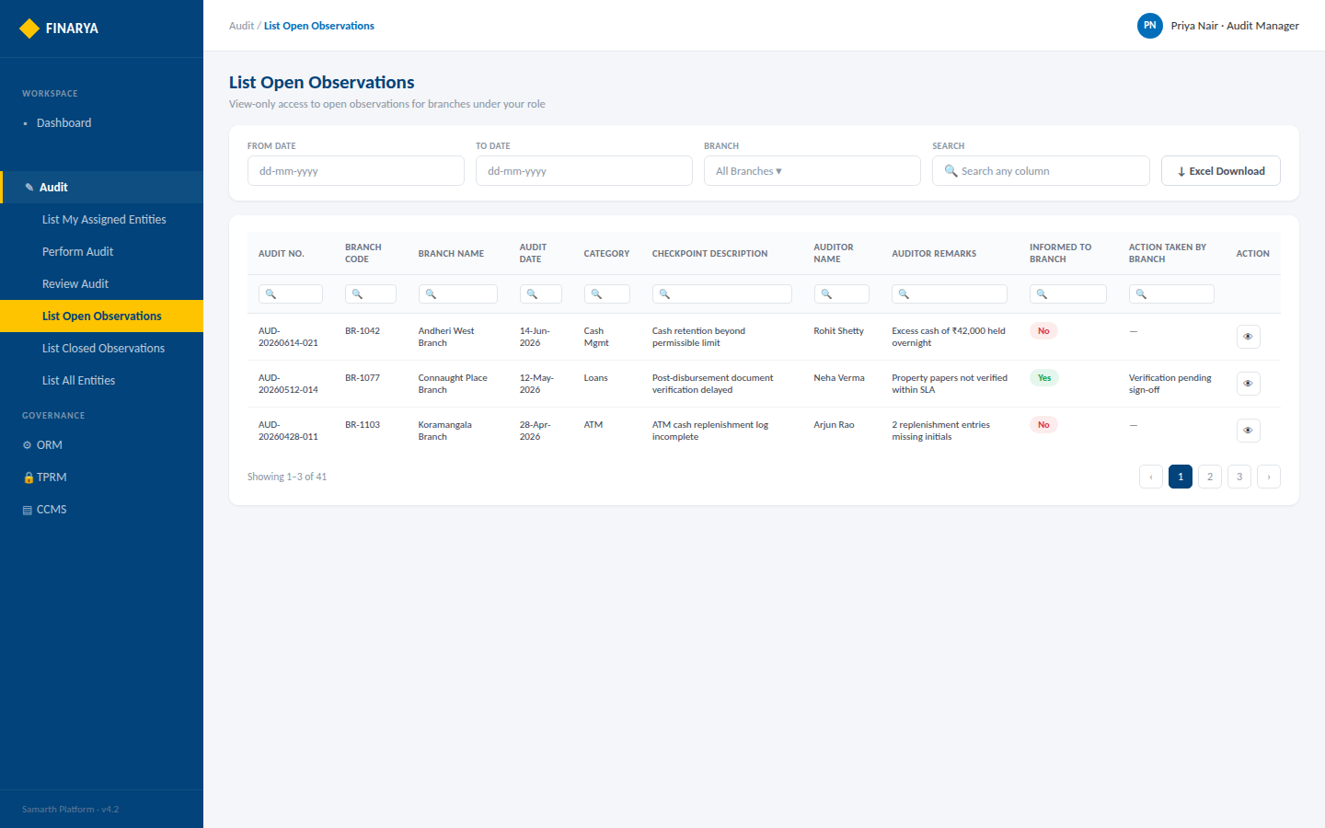
FINARYA
List Open Observations — Administrator / Audit Manager
View-only access; Bulk Download/Upload hidden — Branch filter scoped to role
Finarya — Reimagine Governance
Open interactive prototype ↗
4

Slide 29
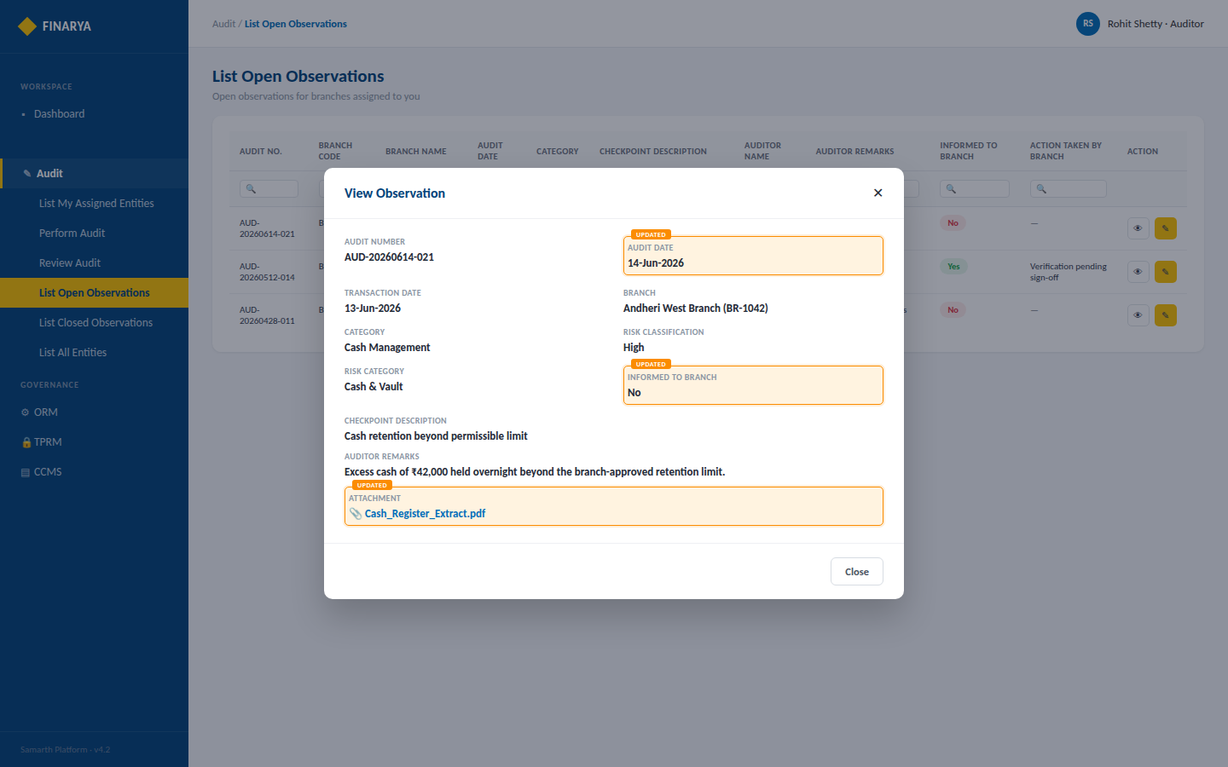
FINARYA
View Observation — Dialog
Read-only popup with full observation and attachment details
Finarya — Reimagine Governance
Open interactive prototype ↗
5

Slide 30
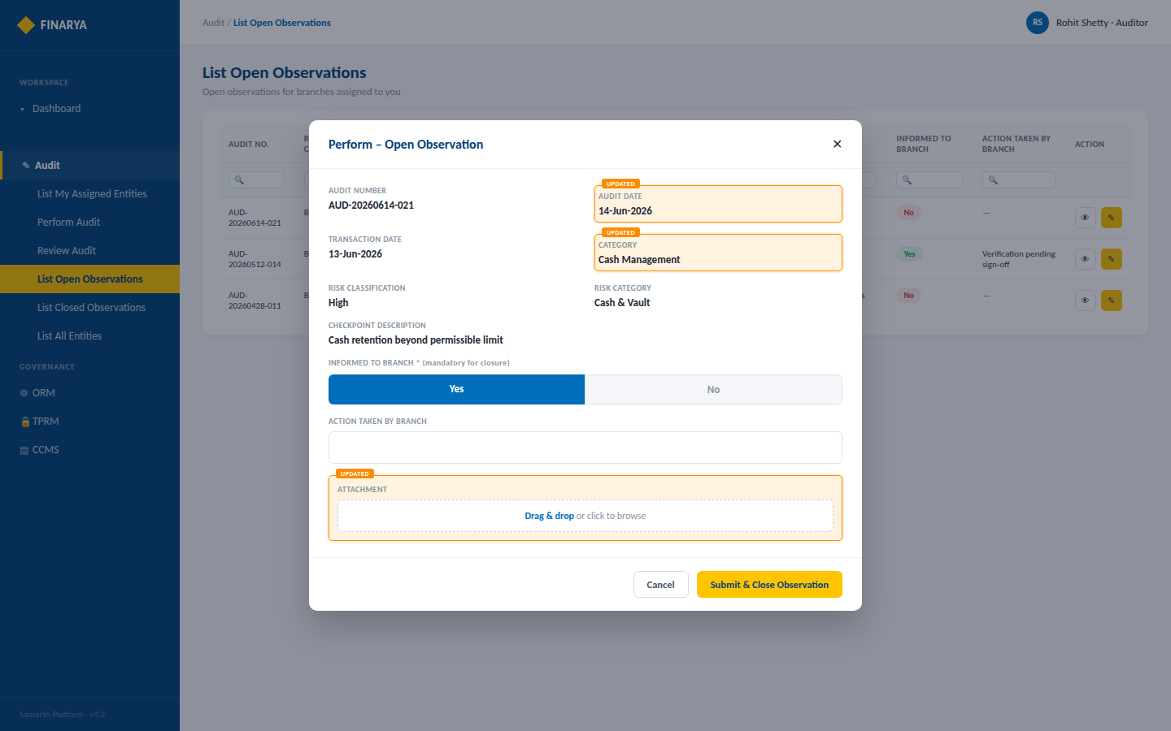
FINARYA
Perform Observation — Dialog (Auditor only)
Informed to Branch, Action Taken and attachment — submission closes the observation
Finarya — Reimagine Governance
Open interactive prototype ↗
6

Slide 31
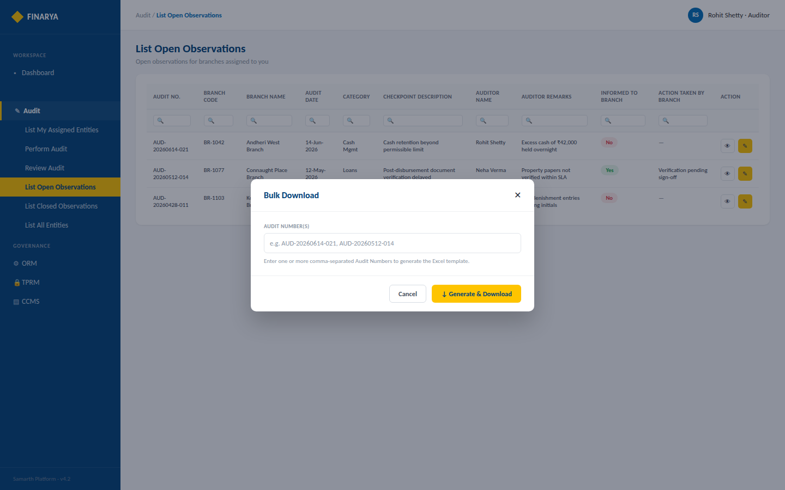
FINARYA
Bulk Download — Dialog
Enter one or more comma-separated Audit Numbers to generate the Excel template
Finarya — Reimagine Governance
Open interactive prototype ↗
7

Slide 32
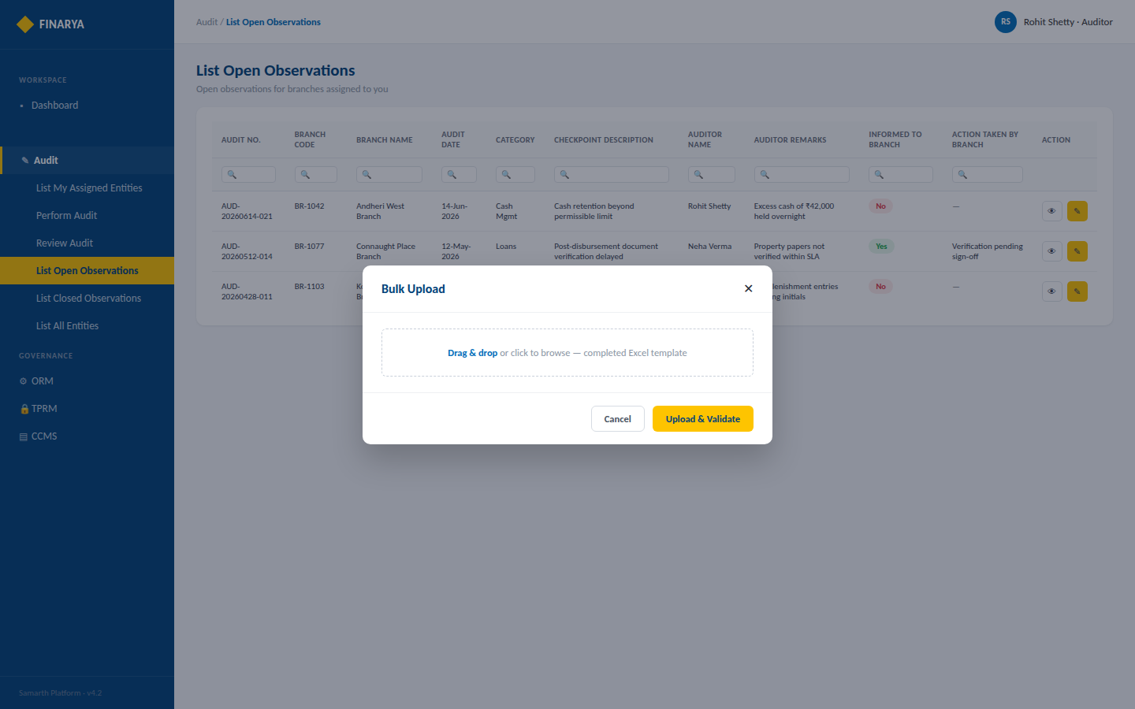
FINARYA
Bulk Upload — Dialog
Upload the completed system-generated Excel for validation
Finarya — Reimagine Governance
Open interactive prototype ↗
8

Slide 33
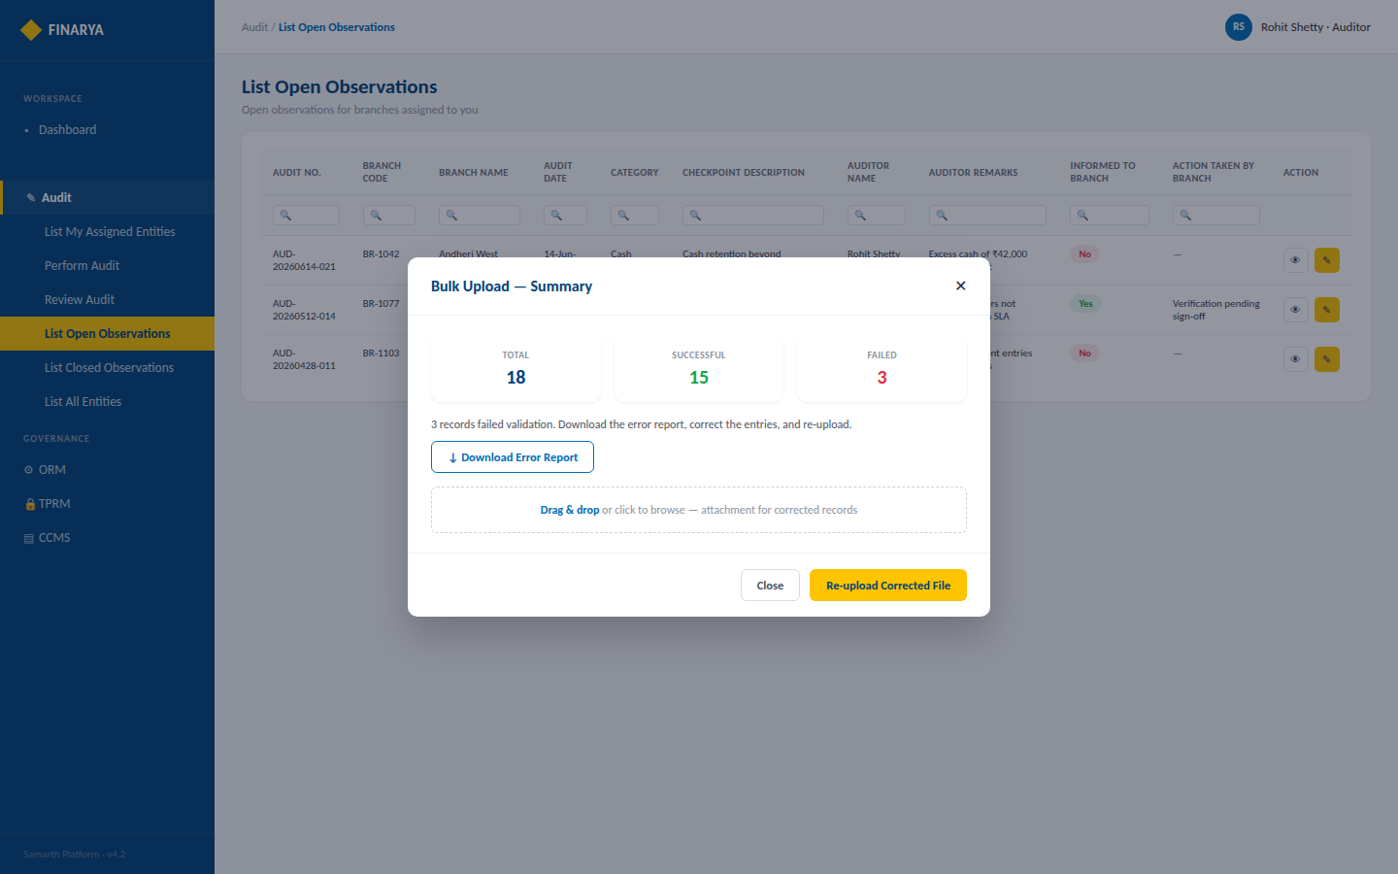
FINARYA
Bulk Upload — Summary
Total / Successful / Failed record counts, with a downloadable error report
Finarya — Reimagine Governance
Open interactive prototype ↗
9

Slide 34
FINARYA
List Closed Observations
Screen mock-up set — role-based closed observation grid, the read-only View dialog, the Reopen workflow, and the multi-cycle Audit Trail
Open interactive HTML prototype ↗
Keep this PPTX and Finarya_ListClosedObservations_Prototype.html in the same folder for the link above to open correctly.
Brand colours used: #016EBA · #1375BE · #FEC400

Slide 35
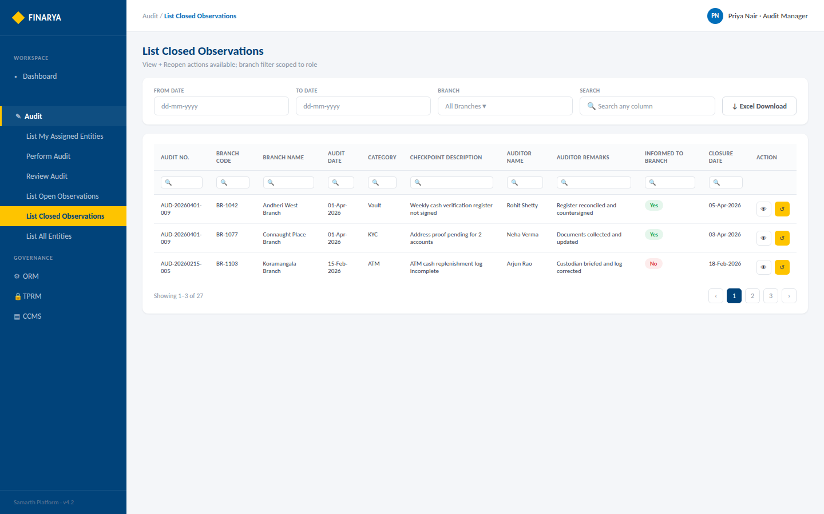
FINARYA
List Closed Observations — Administrator / Audit Manager
View + Reopen actions available; branch filter scoped to role
Finarya — Reimagine Governance
Open interactive prototype ↗
3

Slide 36
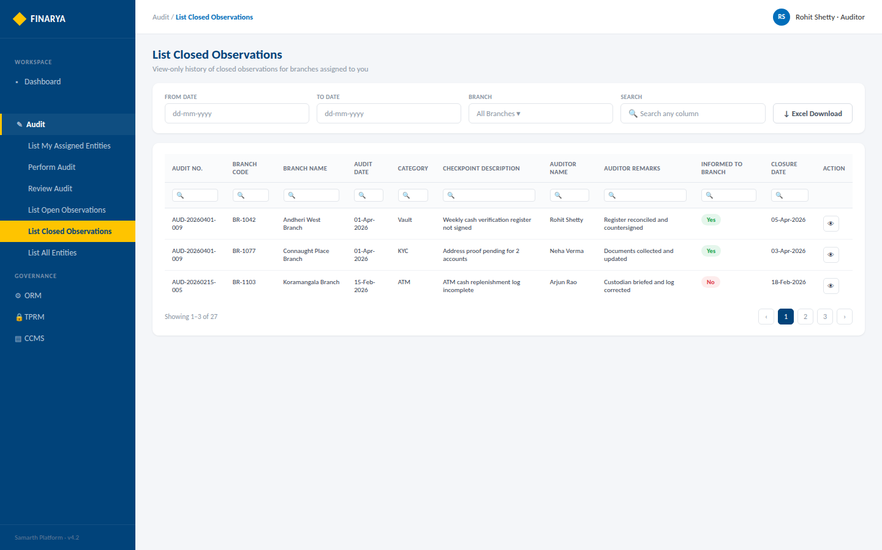
FINARYA
List Closed Observations — Auditor
View only — Reopen is not available to the Auditor
Finarya — Reimagine Governance
Open interactive prototype ↗
4

Slide 37
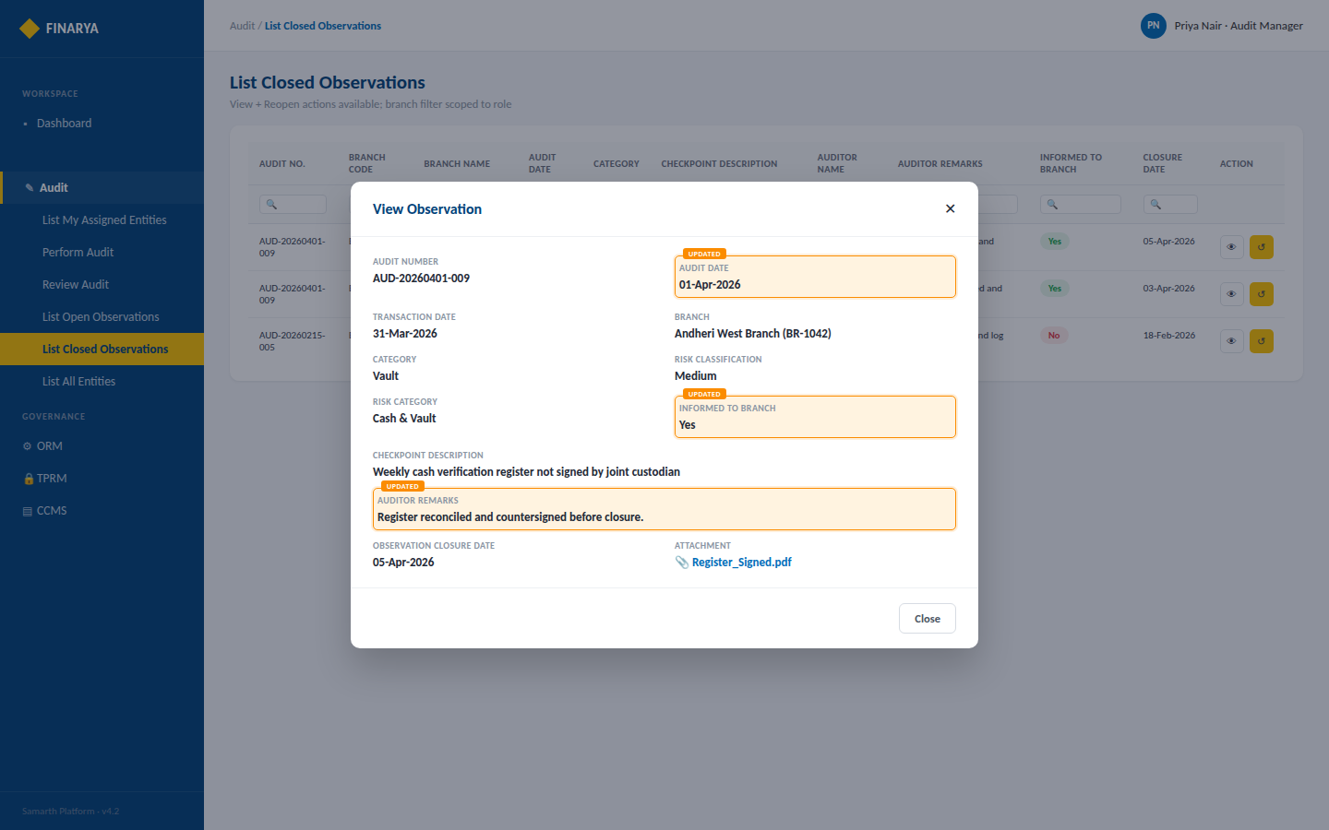
FINARYA
View Observation — Dialog
Read-only popup including Observation Closure Date and attachments
Finarya — Reimagine Governance
Open interactive prototype ↗
5

Slide 38
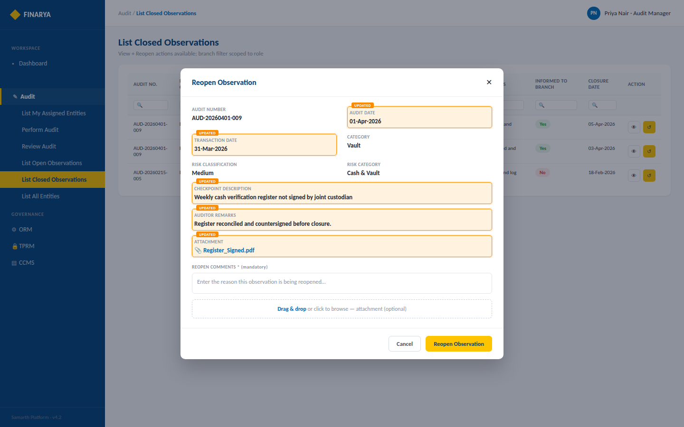
FINARYA
Reopen Observation — Dialog (Administrator / Audit Manager only)
Mandatory Reopen Comments and optional attachment before the observation moves back to Open
Finarya — Reimagine Governance
Open interactive prototype ↗
6

Slide 39
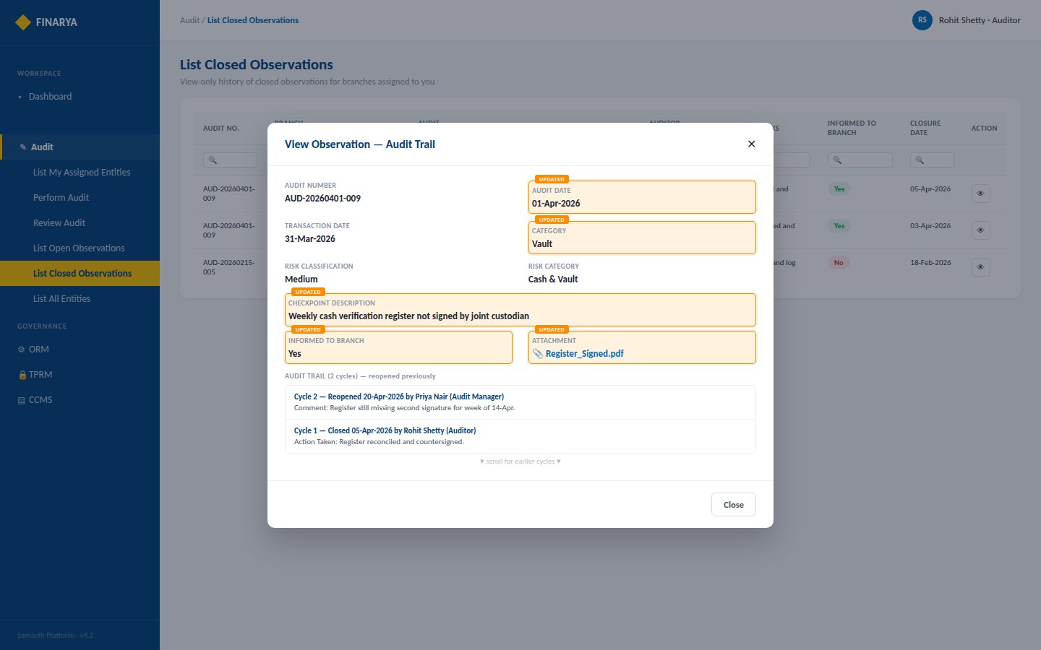
FINARYA
View Observation — with Audit Trail
Chronological record of every reopen / closure cycle for observations reopened before
Finarya — Reimagine Governance
Open interactive prototype ↗
7

Slide 40
FINARYA
List All Entities
Screen mock-up set — Administrator-only view of every configured branch, ticket-based layout, in Populated, Search and Empty states
Open interactive HTML prototype ↗
Keep this PPTX and Finarya_ListAllEntities_Prototype.html in the same folder for the link above to open correctly.
Brand colours used: #016EBA · #1375BE · #FEC400

Slide 41
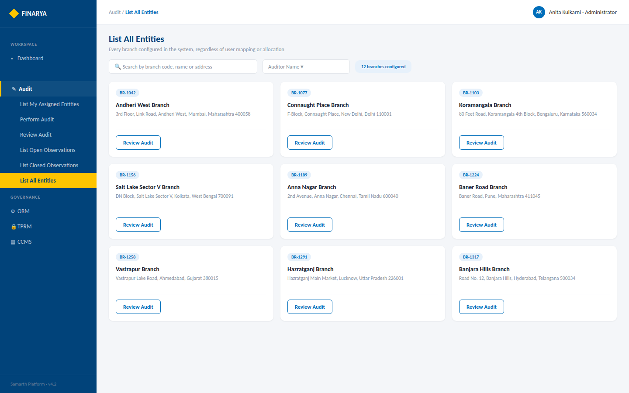
FINARYA
List All Entities — Populated
All configured branches, ticket-based layout — Review Audit only, no Perform Audit
Finarya — Reimagine Governance
Open interactive prototype ↗
3

Slide 42
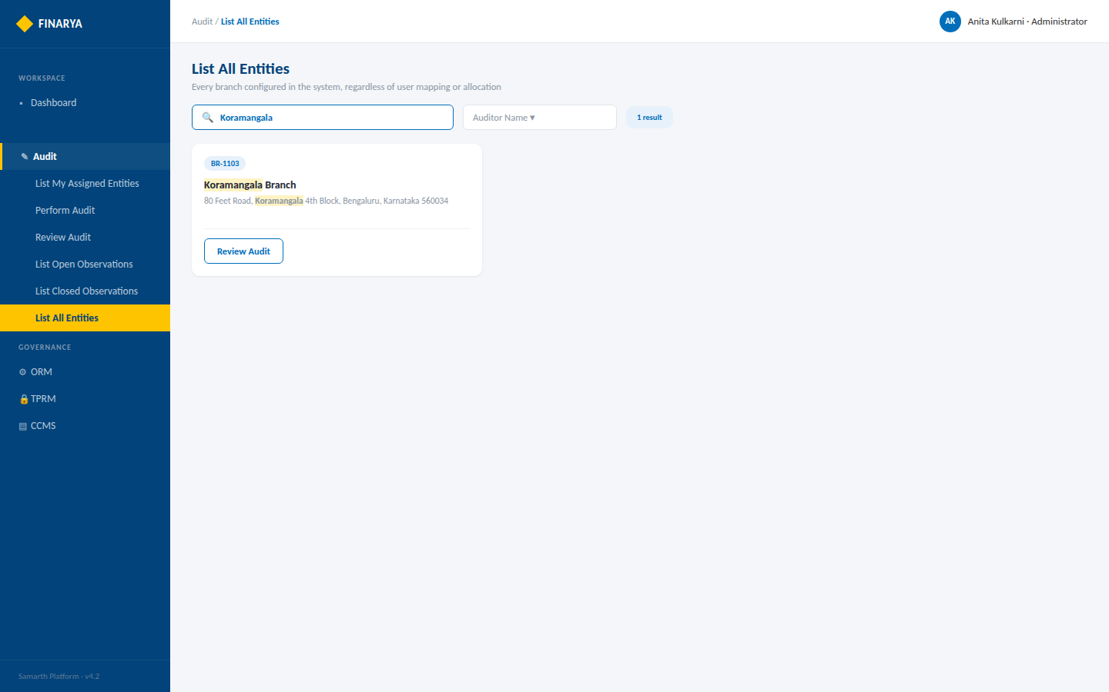
FINARYA
List All Entities — Search Active
Live filter across Branch Code, Branch Name and Branch Address
Finarya — Reimagine Governance
Open interactive prototype ↗
4

Slide 43
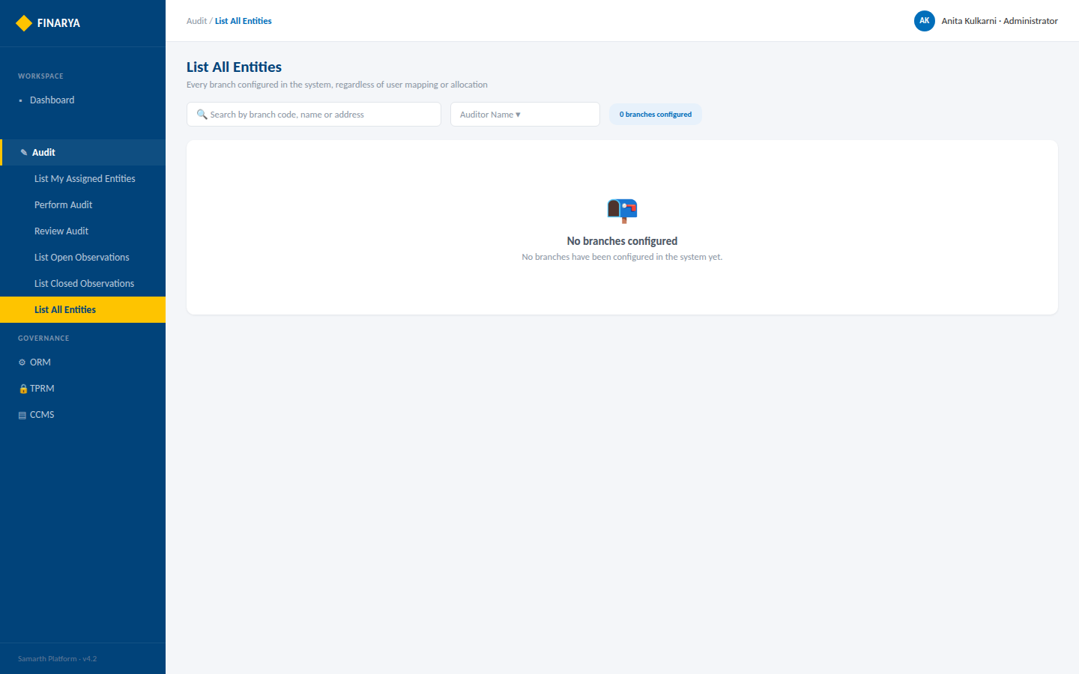
FINARYA
List All Entities — Empty State
No branches configured in the system
Finarya — Reimagine Governance
Open interactive prototype ↗
5

